Slide 1
Lecture 23
Project Management
BSCS(Software Engineering-I) SZABIST-Islamabad

Slide 2
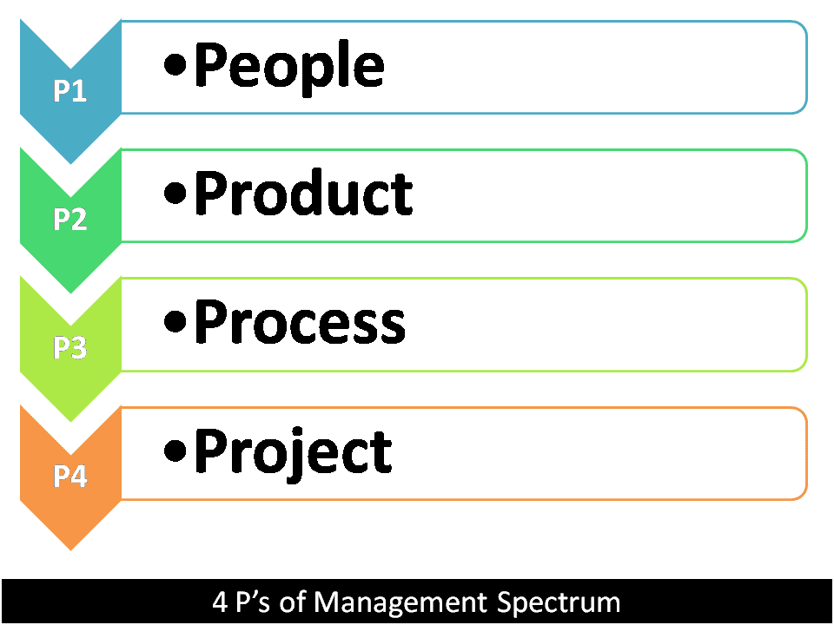
Management Spectrum
Effective software project management focuses on the four P's: people, product, process, and project.
BSCS(Software Engineering-I) SZABIST-Islamabad

Slide 3
1.The People
People factor is very much important in the process of software development.
There are following areas for software people like, recruiting, selection, performance management, training, compensation, career development, organization and work design, and team/culture development.
    The Stakeholders
    Team Leaders
    The software team
    Agile Team
    Coordination and Communication issues
BSCS(Software Engineering-I) SZABIST-Islamabad

Slide 4
2. The Product
Before a project can be planned, product objectives and scope should be established, alternative solutions should be considered and technical and management constraints should be identified.
Without this information, it is impossible to define reasonable estimates of the cost, an effective assessment of risk, a realistic breakdown of project tasks, or a manageable project schedule.
Objectives identify the overall goals for the product without considering how these goals will be achieved.
Scope identifies the primary data, functions and behaviors that characterize the product.
    Software Scope
    Problem Decomposition
BSCS(Software Engineering-I) SZABIST-Islamabad

Slide 5
3. The Process
A software process provides the framework from which a comprehensive plan for software development can be established.
A small number of frame-work activities are applicable to all software projects, regardless of their size or complexity.
  A number of different tasks
  Milestones
  Quality assurance points
BSCS(Software Engineering-I) SZABIST-Islamabad

Slide 6
4. The Project
Project Mangers conduct planned and controlled software projects for one primary reason it is the only known way to manage complexity.
A software project manager and the software engineers who build the product must watch common warning signs, understand the critical success factors that lead to good project management, and develop a common sense approach for planning, monitoring and controlling the project.
Example:
Lengthening cycle times – rising on-hold time within development
Rising return rates (tickets returned from QA/UAT to development for further work)
Reduced sprint target completion (and rising WIP queues)
Increased “parallel” work outside sprints - “pulling in a favour”
Persistent scope creep
BSCS(Software Engineering-I) SZABIST-Islamabad

Slide 7
Top 5 early warning signs
1. Lengthening cycle times:
Project Manager must carefully watch cycle times as it could vary for many different reasons.
For example, Lengthen could be happened with two reason 1) as teams tackle complex project areas 2) but teams which show a persistent trend of lengthening cycle times require investigation and potential early intervention by PMs.
  Pre-development “On-hold” Time – where tickets are held waiting to be actioned as a result of input required (and not forthcoming) from a stakeholder or engineer
  Development Cycle “On-hold” Time – where tickets are frozen pending a dependency within the team
  QA delays -potentially as a result of problems, environment setup or resource issues within QA.
BSCS(Software Engineering-I) SZABIST-Islamabad

Slide 8
Top 5 early warning signs
2. Rising return rates:
This is one of the most important warning sign that each project manager must watch carefully. This could happened with two reasons 1) your best engineers wrestling with the most complex of coding issues, 2) but it can also be indicative of problems within a development team.
Example: defect tickets returned from QA/UAT to development for further work
BSCS(Software Engineering-I) SZABIST-Islamabad

Slide 9
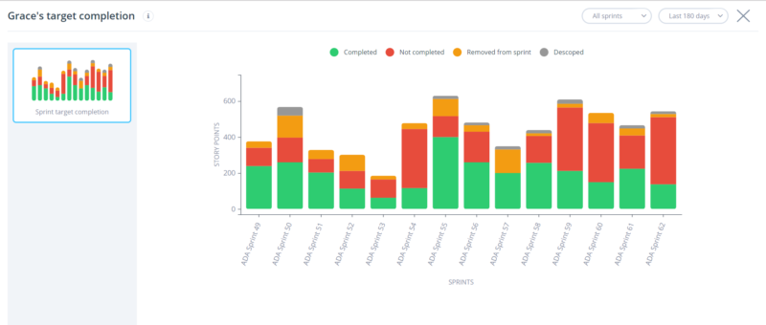
Top 5 early warning signs
3. Reduced Sprint Target Completion:
This is one of the important warning sign that each project manager must watch carefully that are we hitting our targets? Reason: Key metrics relating to teams’ inability to deliver sprint goals include analysis of Overdues and WIP Queues
Example: shows clearly individual
team’s sprint completion performance
over time and why targets were not
hit (i.e. where tickets were not
completed, removed from the
sprint or descoped).
BSCS(Software Engineering-I) SZABIST-Islamabad

Slide 10
Top 5 early warning signs
4. Increased “Parallel” Work Outside Sprints
The Project Manager must need to make sure if his team is involved outside the sprint activities.
Reason: Teams tend to introduce a Scrum Agile methodology with tight disciplines at the outset. But projects are complex and the pressures on teams varied (often juggling multiple stakeholders, with conflicting priorities). As a result, a disciplined Scrum Agile methodology with clearly defined sprint goals can often deteriorate.
Example:
In more serious cases – parallel streams of work being undertaken for a different stakeholder “pulling in a favour”.
Organization Rules – Trainings/seminars.
Reporting to multiple persons.
BSCS(Software Engineering-I) SZABIST-Islamabad

Slide 11
Top 5 early warning signs
5. Persistent Scope Creep
The most common and often most significant early warning sign of potentially problematic projects is unsurprisingly scope creep. Agile brings stakeholders closer to the development process which is clearly a very good thing, but the downside is that it is easy for stakeholders to move the goal posts.
Reason: Scope creep/ requirement creep in project management refers to changes, continuous or uncontrolled growth in a project's scope, at any point after the project begins. This can occur when the scope of a project is not properly defined, documented, or controlled.
Example: A key client may make a specific demand to management that some unplanned feature be included in the next product delivery, with threats to take their business elsewhere if these demands are not met. Managers often respond to these types of business pressures by dictating what happens next. While there may be practical business reasons for honoring the client demand, any such changes should still be handled with the appropriate process
BSCS(Software Engineering-I) SZABIST-Islamabad

Slide 12
Projects, Programs and Portfolio
Project: A temporary endeavor undertaken to create a unique product, service or result.
Program: A group of related projects managed in a coordinated way to obtain benefits and control not available from managing them individually.
Portfolio: A collection of projects or programs and other work that are grouped together to facilitate effective management of that work to meet strategic business objectives.
BSCS(Software Engineering-I) SZABIST-Islamabad

Slide 13
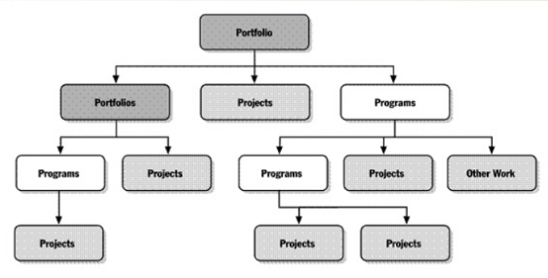
Projects, Programs and Portfolio
BSCS(Software Engineering-I) SZABIST-Islamabad

Slide 14
Defining Project Management
Software project management
It is the practice of initiating, planning, executing, controlling, and closing the work of a team to achieve specific goals and meet specific success criteria at the specified time. ... The primary challenge of project management is to achieve all of the project goals within the given constraints.
BSCS(Software Engineering-I) SZABIST-Islamabad

Slide 15
Project Management Life-Cycle
Project Initiation
Project Planning
Project Execution
Project Closure
BSCS(Software Engineering-I) SZABIST-Islamabad

Slide 16
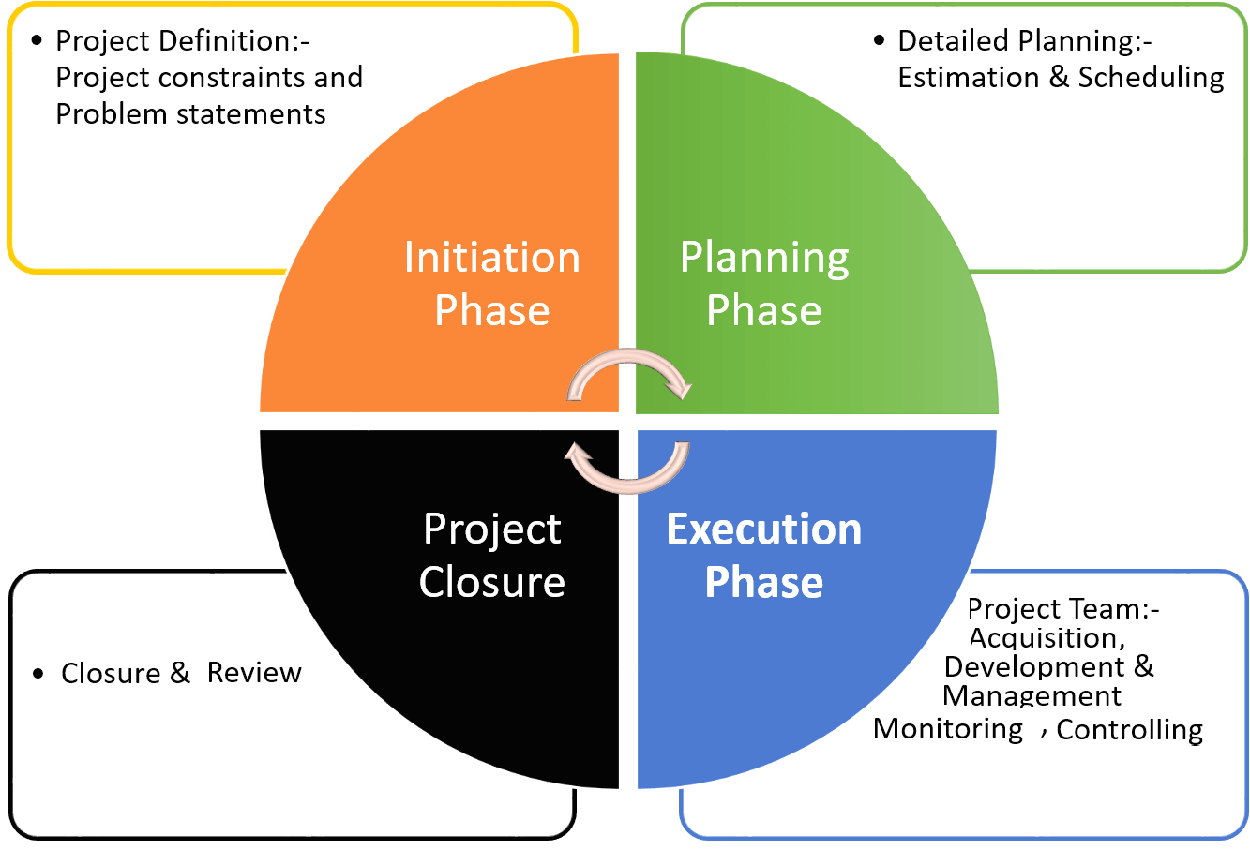
Project Management Life-Cycle
BSCS(Software Engineering-I) SZABIST-Islamabad

Slide 17
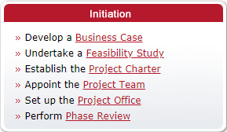
Project Initiation
BSCS(Software Engineering-I) SZABIST-Islamabad

Slide 18
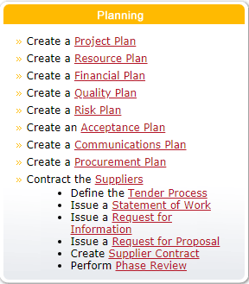
Project Planning
BSCS(Software Engineering-I) SZABIST-Islamabad

Slide 19
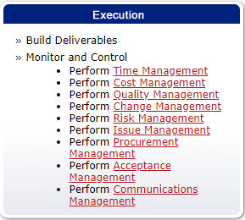
Project Execution
BSCS(Software Engineering-I) SZABIST-Islamabad

Slide 20

Project Closure
BSCS(Software Engineering-I) SZABIST-Islamabad

